Slide 1


Becton Dickinson - Rutgers MBS Externship Exchange Projects
Jenny Chen, Fiona Lee, Usama Saifi, Rudy Winkler, Aditi Kulkarni, Felicia Liu
Advisors: Dr. Christie Nelson, Lilian Vinagre, Jeanne Helfant, Hemen Patel

Slide 2
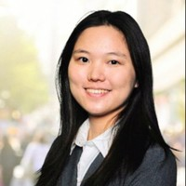
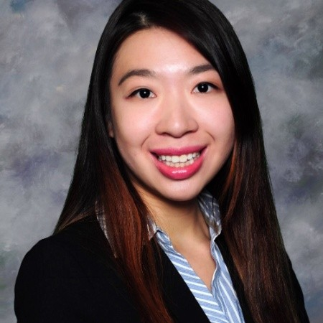
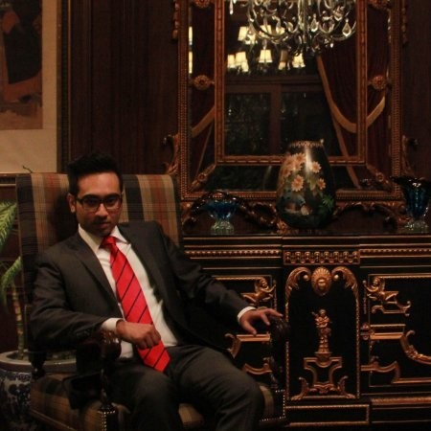
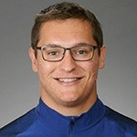
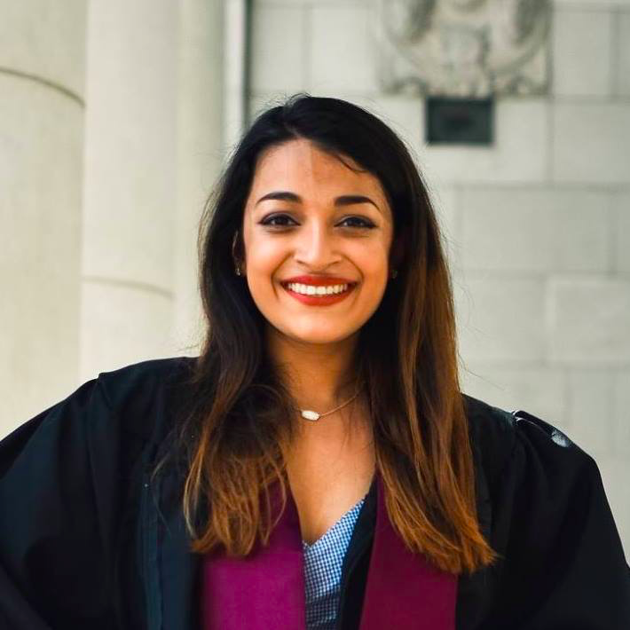
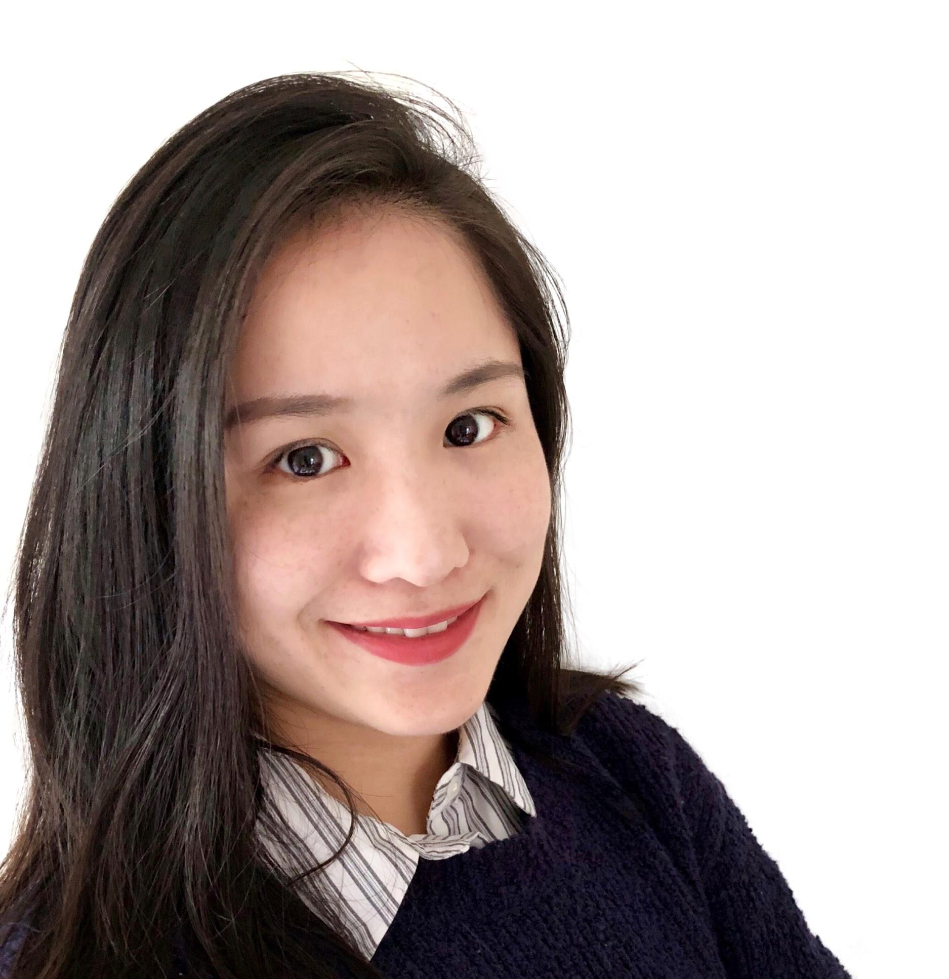
Rutgers MBS Team Overview
Jenny Chen
Fiona Lee
Usama Saifi
Rudy Winkler
Aditi Kulkarni
Wanfei (Felicia) Luo

Slide 3

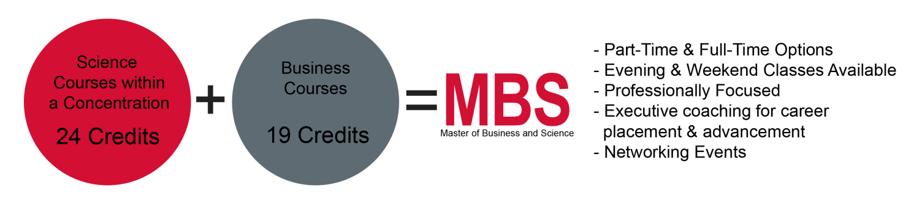
Background On the MBS Degree Program
Rutgers University offers a Professional
Science Master’s Program called the
Master of Science and Business (MBS) degree

Slide 4
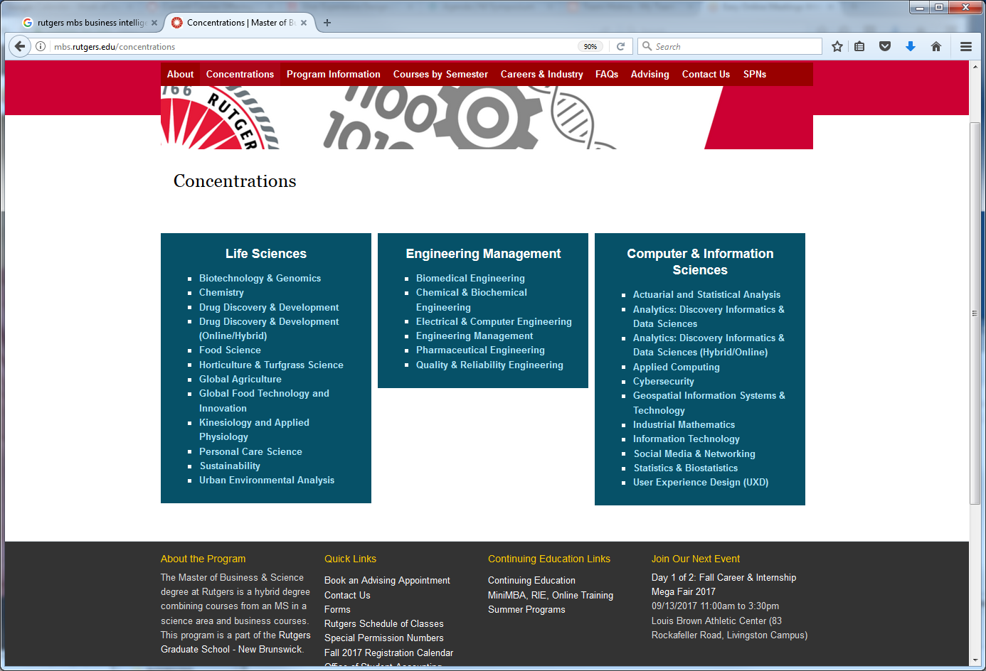
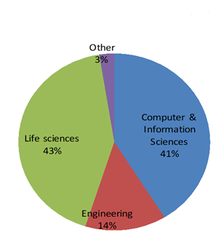
MBS Tracks and Concentrations

Slide 5
Ways to Partner with MBS
Externships
Analytics Practicums
Class Projects
Internships
Be a Panelist / Guest Speaker / Student Mentor
Create Talent Pipeline to Students and Alumni
Post your Job Opportunities
Host a Career Session

Slide 6
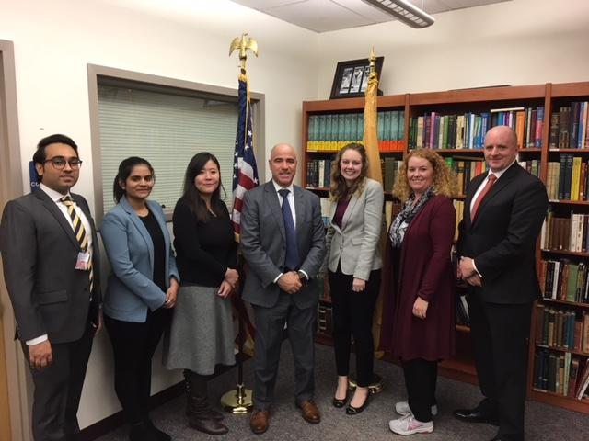
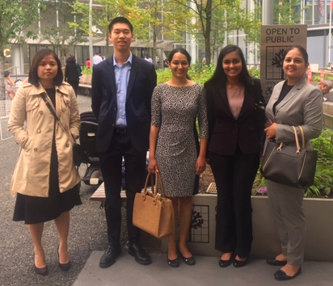
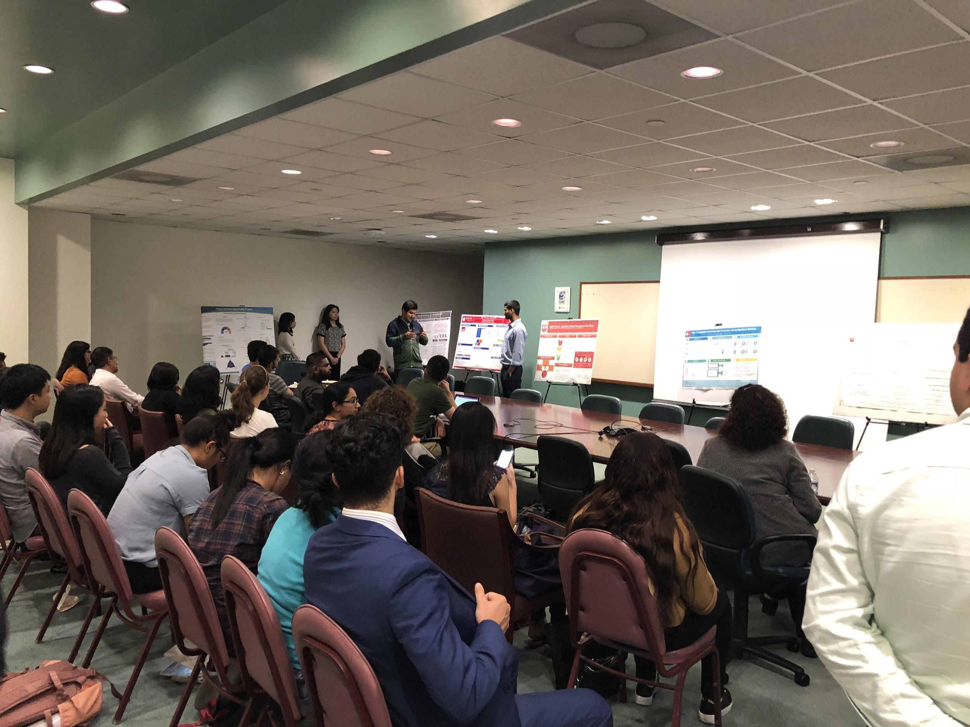
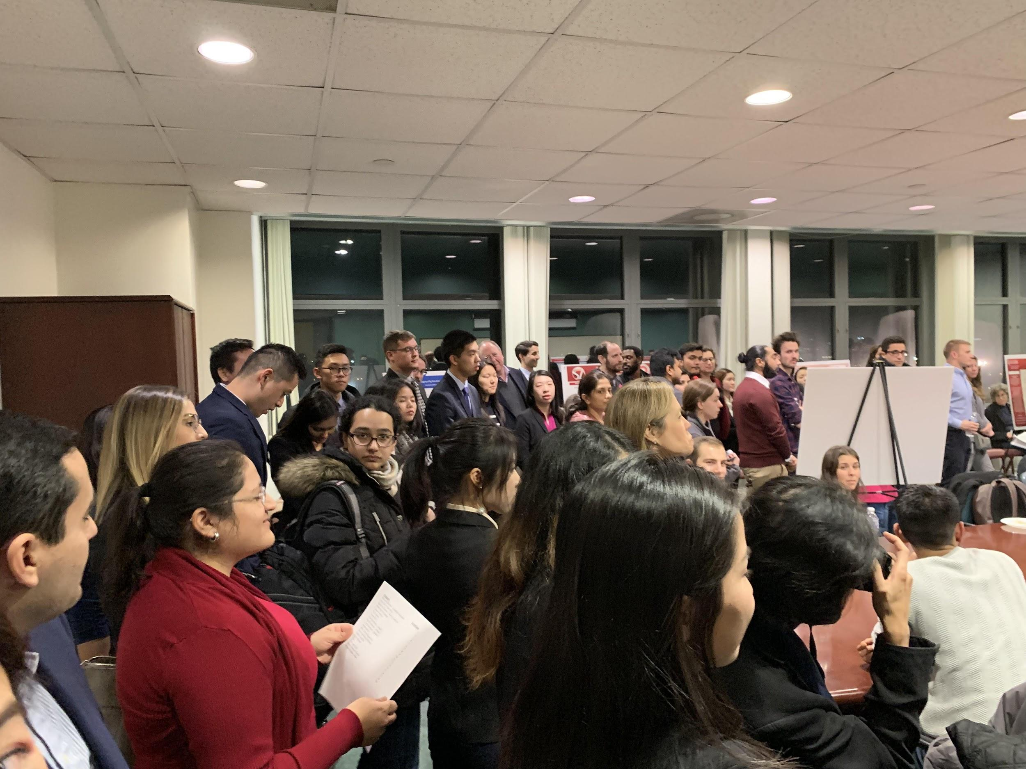
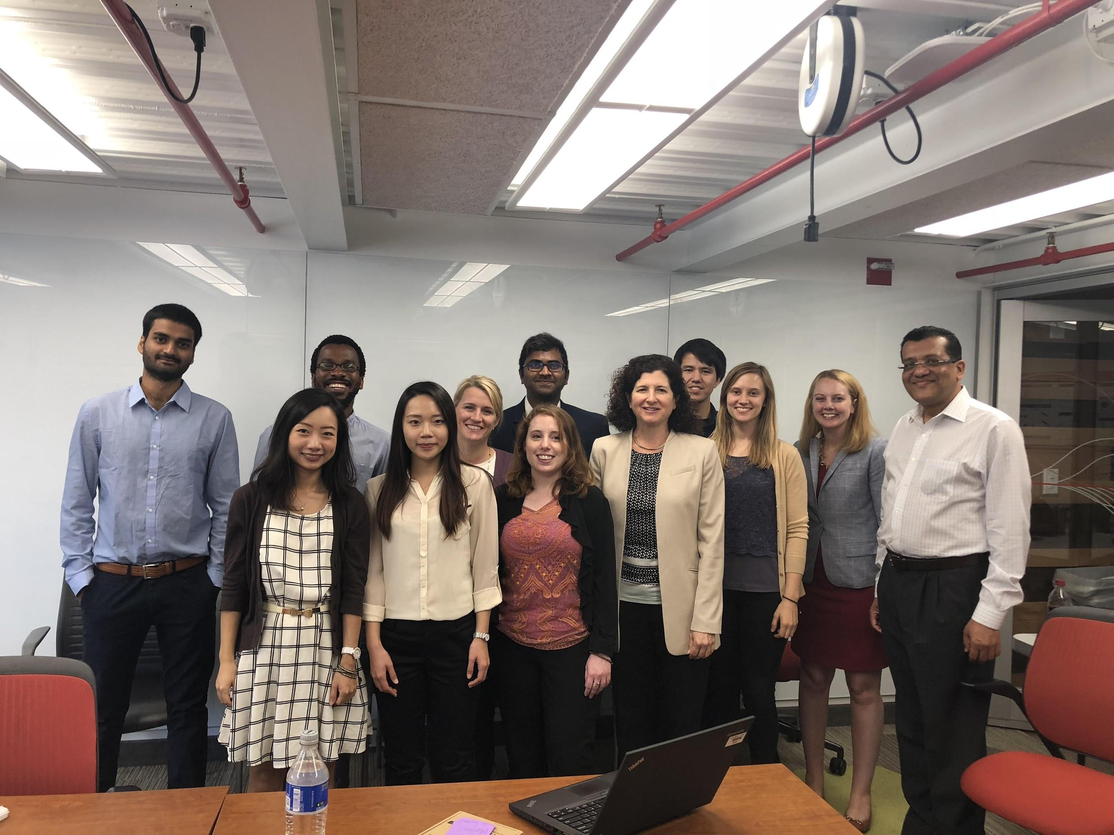
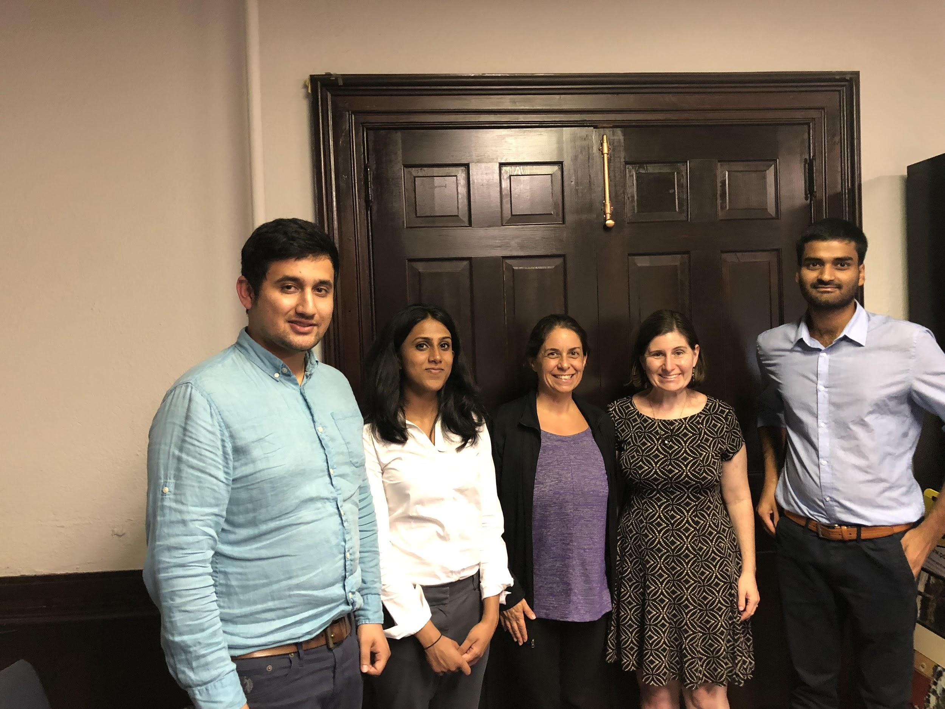
Some of Our Current/Past Externships
40+ organizations
80+ projects
320+ student spots

Slide 7
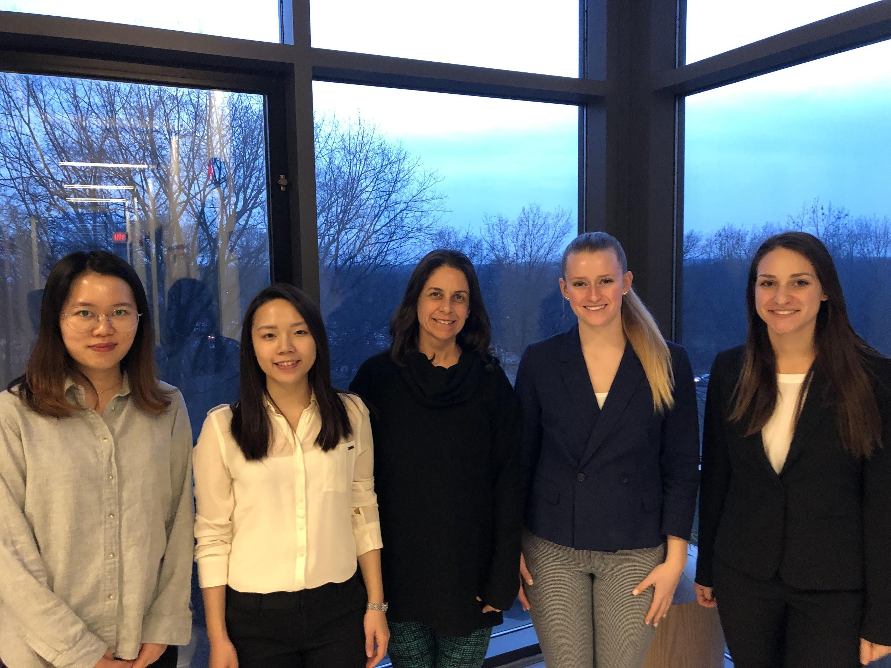
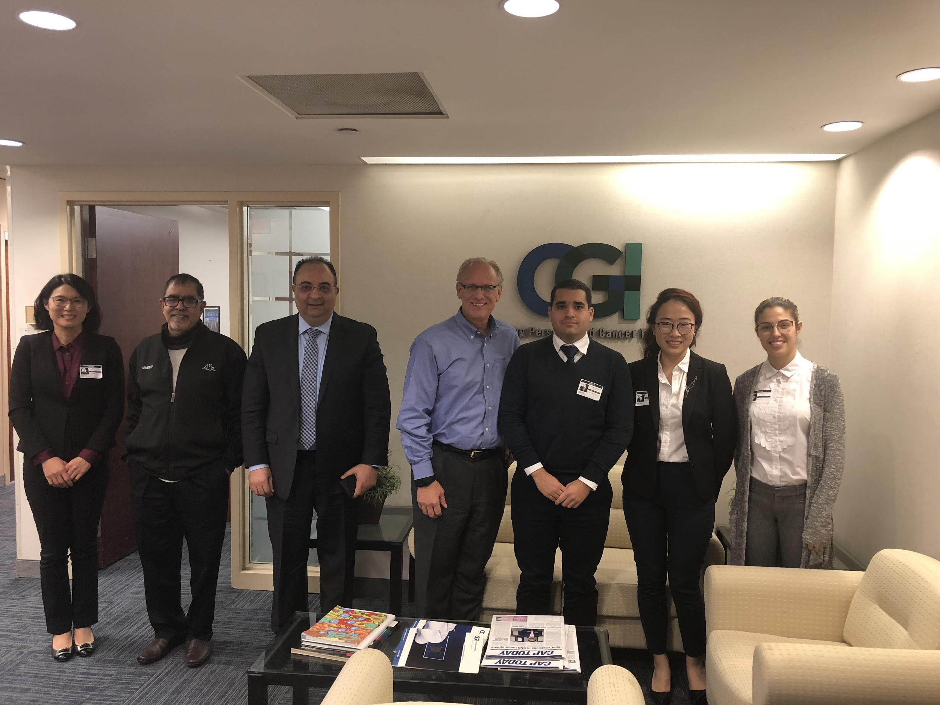
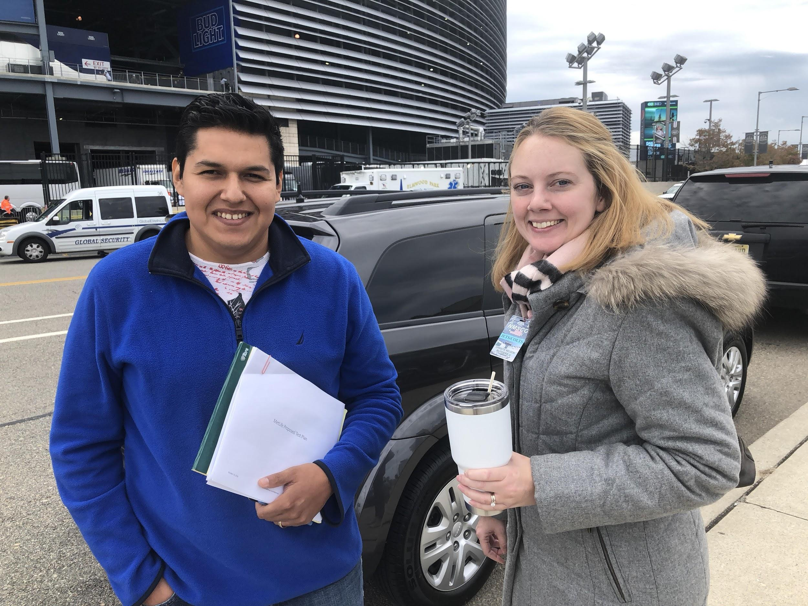
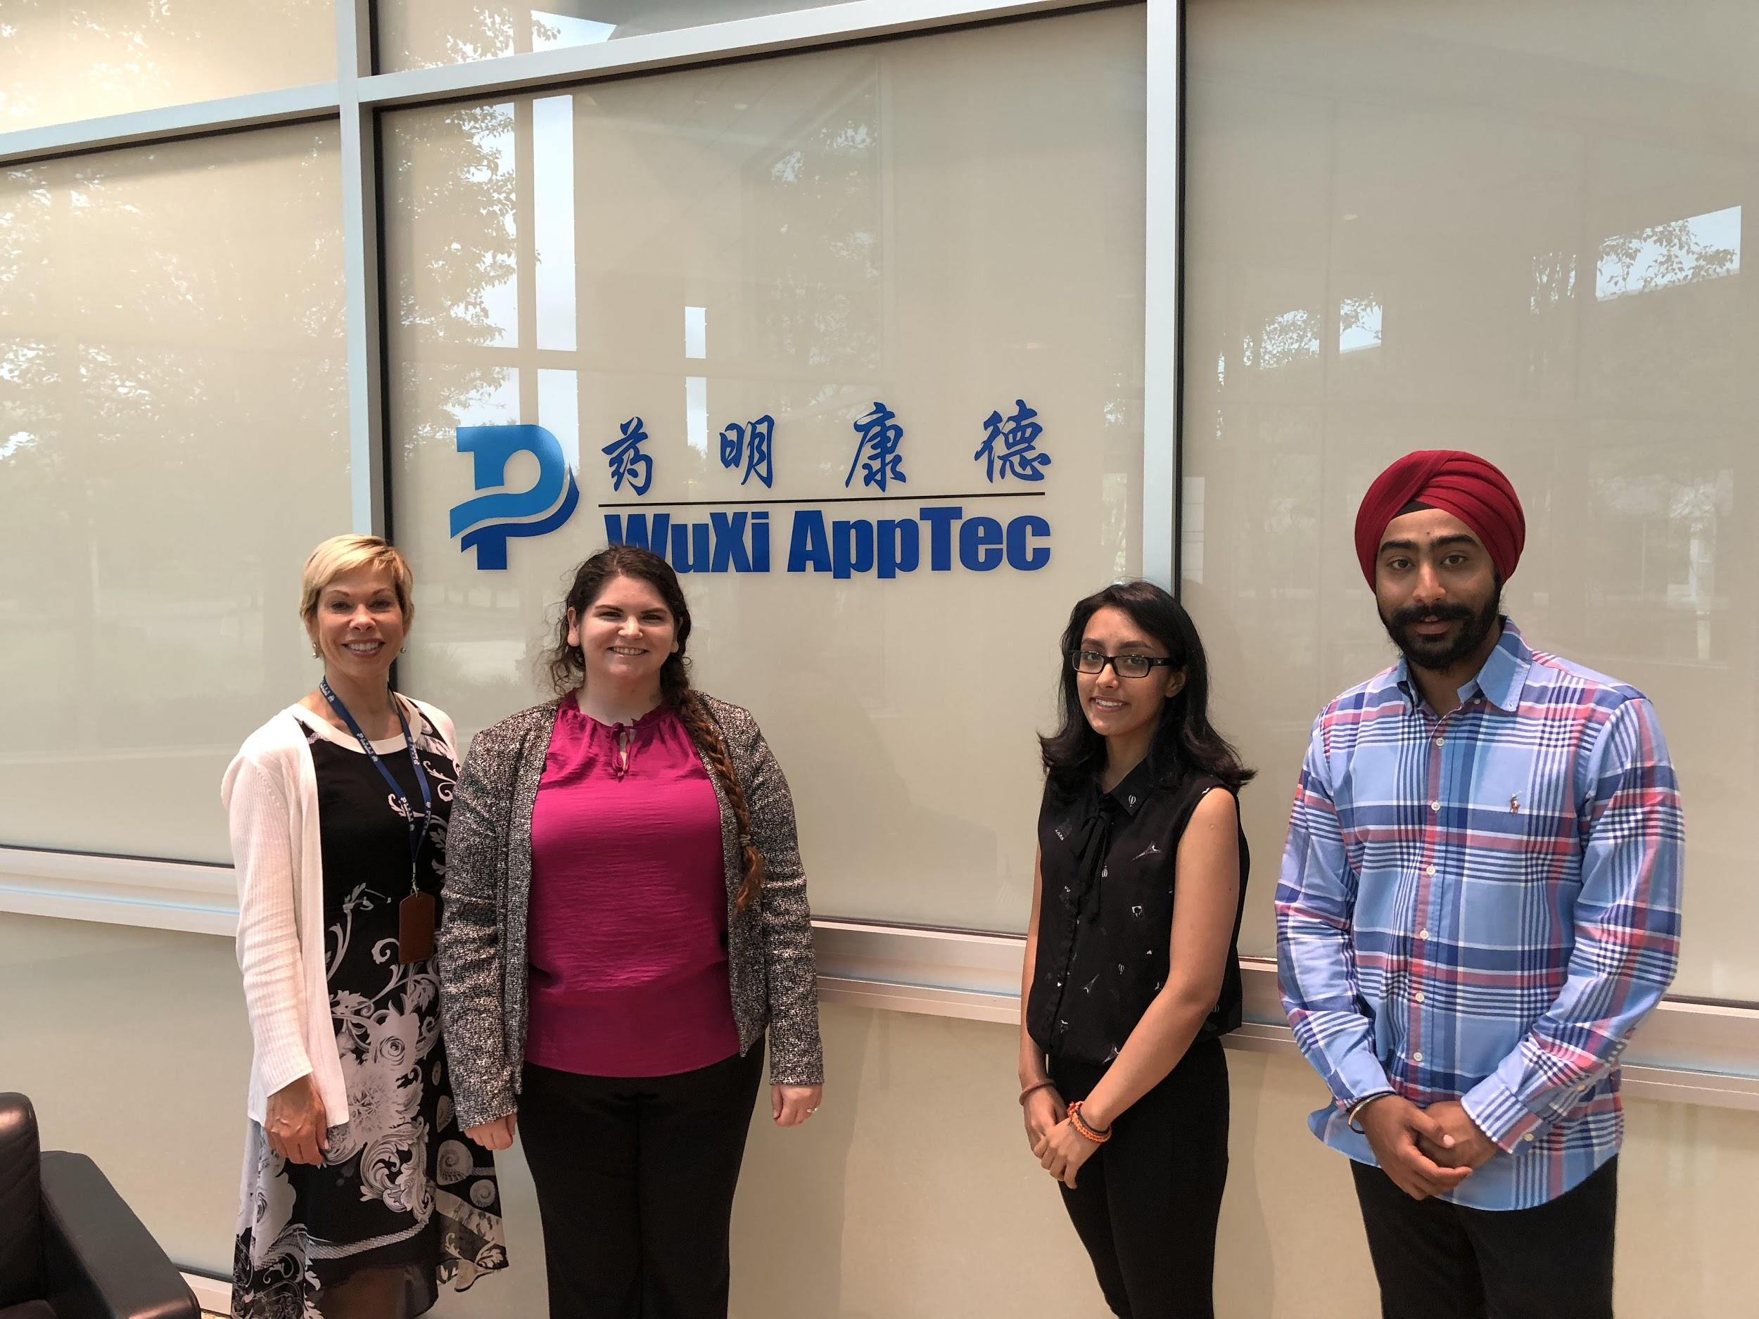
Some of Our Current/Past Externship Partners
Becton Dickinson
Citi Ventures
NJ State Police
Nielsen
Sepsis Alliance
J&J
Janssen
Ortho Clinical Diagnostics
Vydia
Conrail
TSA
& more!

Slide 8
Follow up questions?
Thank you for partnering with us!
MBS Contact:
Dr. Christie Nelson cnelson@dimacs.rutgers.edu
Additional Information about our Externship Exchange can also be found at: mbs.rutgers.edu/externships

Slide 9
Becton Dickinson - Rutgers MBS Exchange
Part I
Voice of the Associate Survey Result Exploratory Analysis
Jenny Chen, Fiona Lee, Usama Saifi, Rudy Winkler
Advisors: Dr. Christie Nelson, Lilian Vinagre, Jeanne Helfant, Hemen Patel

Slide 10
VoA Team Overview
Jenny Chen
Fiona Lee
Usama Saifi
Rudy Winkler

Slide 11
Overview
Goal:
In this project, BD is interested in extracting more insight from a large-scale, multinational employee survey on professional ethics in their roles at BD to better determine and prevent risks and improve business decisions.

Slide 12
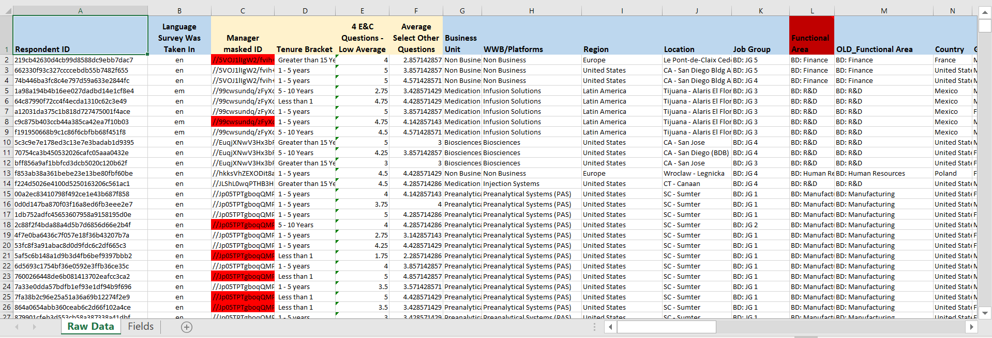
Data - 1
53785 employee entries stored in an excel sheet, with 90 survey criteria. File size 26 MB. Supplemented with analysis powerpoints from BD.

Slide 13
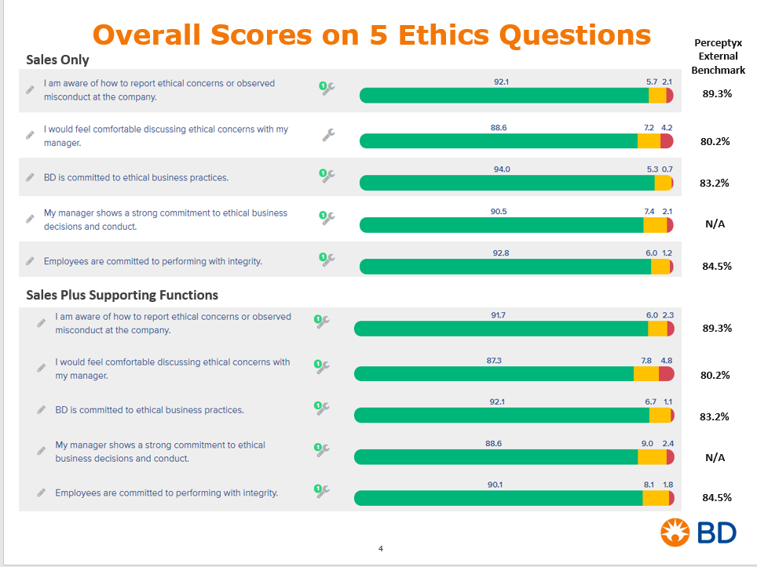
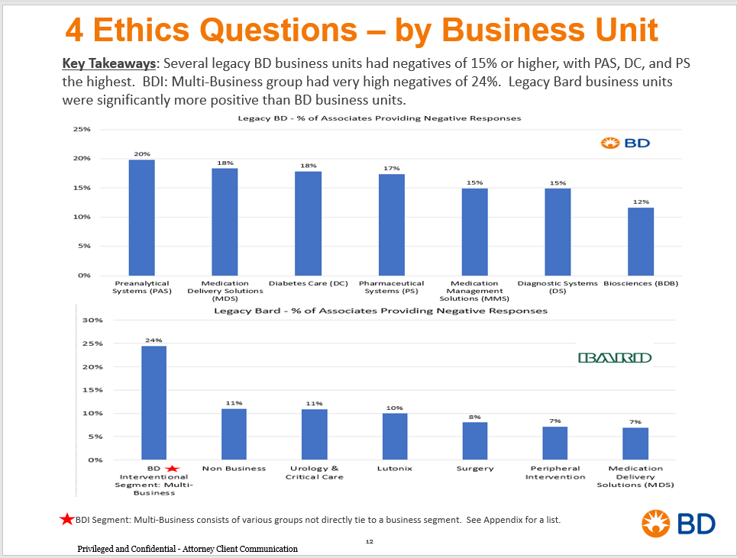
Data - 2
53785 employee entries stored in an excel sheet, with 90 survey criteria. File size 26 MB. Supplemented with analysis powerpoints from BD.

Slide 14
Approach
Utilizing Python to conduct exploratory analytics such as correlation, word cloud, topic modeling, and t-sne
Based on the results from the exploratory analytics, build specific models to test variables and hypothesis to gather deeper insight
In Python, used modules: Panda, numpy, matplotlib, nltk, and wordcloud

Slide 15
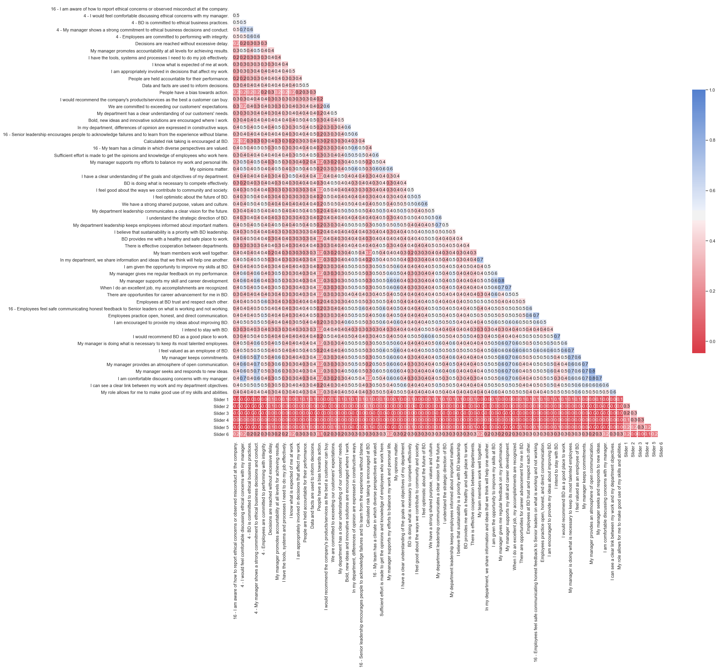
Results - VoA Exploratory Analytics
Key:
Blue - High Correlation
Red - Low Correlation

Slide 16
Highlights
“My manager supports my efforts to balance my work and personal life.” “My opinions matter.” 61% Correlated
“My manager gives me regular feedback on my performance” “My manager supports my skill and career development” 80% Correlation
All manger related questions are correlated 60% or above
“I see a clear link between my work and my department’s objectives” “I am comfortable discussing concerns with my manager” 60% Correlation

Slide 17
Highlights
4 - My manager shows a strong commitment to ethical business decisions and conduct.
-- 4 - I would feel comfortable discussing ethical concerns with my manager.
0.6696173705164487
16 - My team has a climate in which diverse perspectives are valued.
-- In my department, differences of opinion are expressed in constructive ways.
0.6191630995296119
My department leadership keeps employees informed about important matters.
-- My department leadership communicates a clear vision for the future.
0.6593363563918104
My manager supports my skill and career development.
-- 4 - My manager shows a strong commitment to ethical business decisions and conduct.
0.6026504194893165
My manager supports my skill and career development.
-- My manager supports my efforts to balance my work and personal life.
0.6195763270427845
My manager supports my skill and career development.
-- I am given the opportunity to improve my skills at BD.
0.6447436710185882
When I do an excellent job, my accomplishments are recognized.
-- My opinions matter.
0.6110964452683714
When I do an excellent job, my accomplishments are recognized.
-- My manager gives me regular feedback on my performance.
0.6636713290452699
There are opportunities for career advancement for me in BD.
-- I am given the opportunity to improve my skills at BD.
0.6173538052683302
Employees practice open, honest, and direct communication.
-- Employees at BD trust and respect each other.
0.6493202832236025
My manager is doing what is necessary to keep its most talented employees.
-- My manager gives me regular feedback on my performance.
0.6073419799486783
My manager is doing what is necessary to keep its most talented employees.
-- My manager supports my skill and career development.
0.6503803126248446
My manager is doing what is necessary to keep its most talented employees.
-- When I do an excellent job, my accomplishments are recognized.
0.6052115173980116
I feel valued as an employee of BD.
-- My opinions matter.
0.6213720538985812
I feel valued as an employee of BD.
-- I am given the opportunity to improve my skills at BD.
0.6052472669985275
I feel valued as an employee of BD.
-- My manager supports my skill and career development.
0.6061963429240724
I feel valued as an employee of BD.
-- When I do an excellent job, my accomplishments are recognized.
0.6420474830273555
I feel valued as an employee of BD.
-- I would recommend BD as a good place to work.
0.6332326556208497
My manager keeps commitments.
-- 4 - My manager shows a strong commitment to ethical business decisions and conduct.
0.6632663976340216
My manager keeps commitments.
-- My manager gives me regular feedback on my performance.
0.6322954024515262
My manager keeps commitments.
-- My manager supports my skill and career development.
0.6661309259563658
My manager keeps commitments.
-- When I do an excellent job, my accomplishments are recognized.
0.6044415424017536
My manager keeps commitments.
-- My manager is doing what is necessary to keep its most talented employees.
0.7132096996421807
My manager provides an atmosphere of open communication.
-- 4 - I would feel comfortable discussing ethical concerns with my manager.
0.6421996380746638
My manager provides an atmosphere of open communication.
-- 4 - My manager shows a strong commitment to ethical business decisions and conduct.
0.6617059963035498

Slide 18
Insights from Results
Highly correlated questions could be looked into further
Very high correlations (80%+) might mean you don’t need to ask both
Assumptions can be made about some of the other questions if one is very high
Could also be done with specific regions
Refining regions and categories would be needed for further insight

Slide 19
Results - Grouping
What are the criteria/metrics that determine the employee satisfaction the most?
Subsets/clusters of questions based on common themes
Culture
Employee Support
Ethics
Management
Workflow/Processes
Satisfaction Composite
Did further analysis on region based on these subgroups

Slide 20
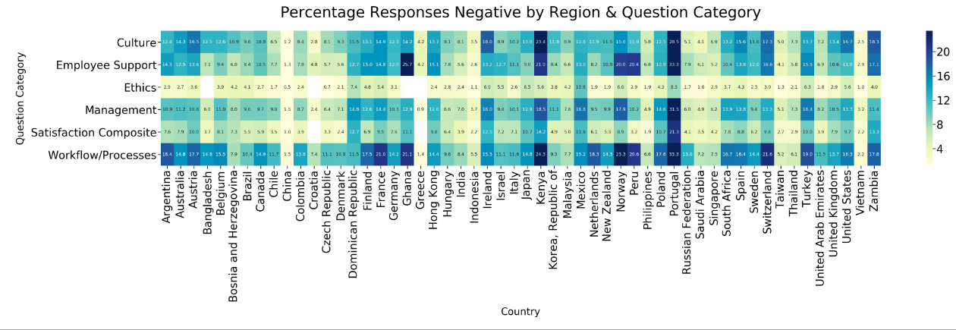
Results - Grouping / Negative Responses

Slide 21
Insights from Results
Chart can give insights into what business areas are suffering in employee’s eyes in certain areas
Chart can give insights into what regions are having difficulties
Grouping questions and regions can lead to further insights

Slide 22
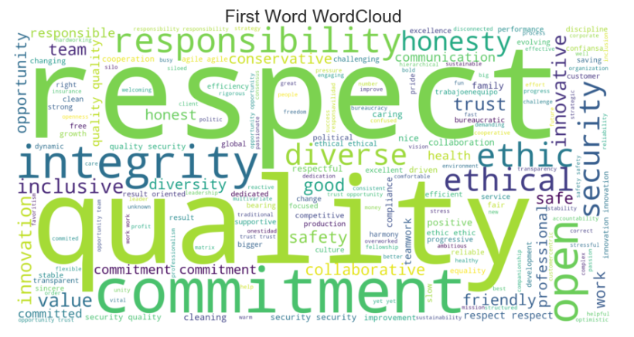
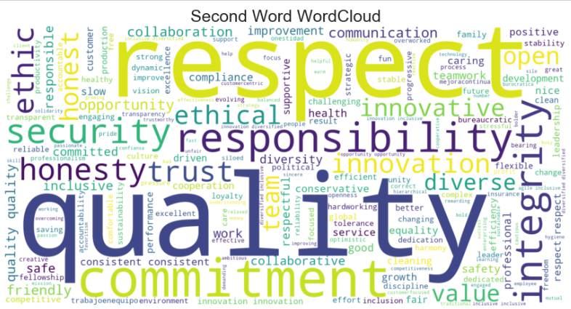
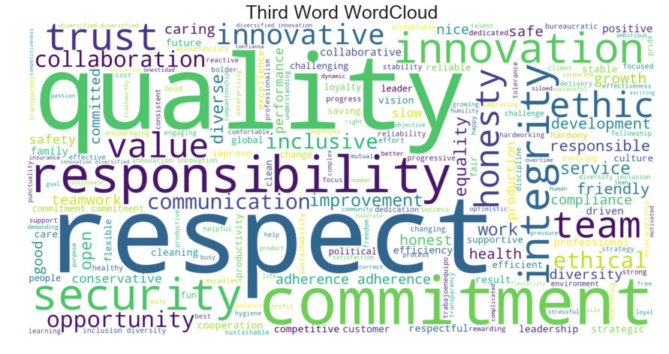
Results - Word Clouds

Slide 23
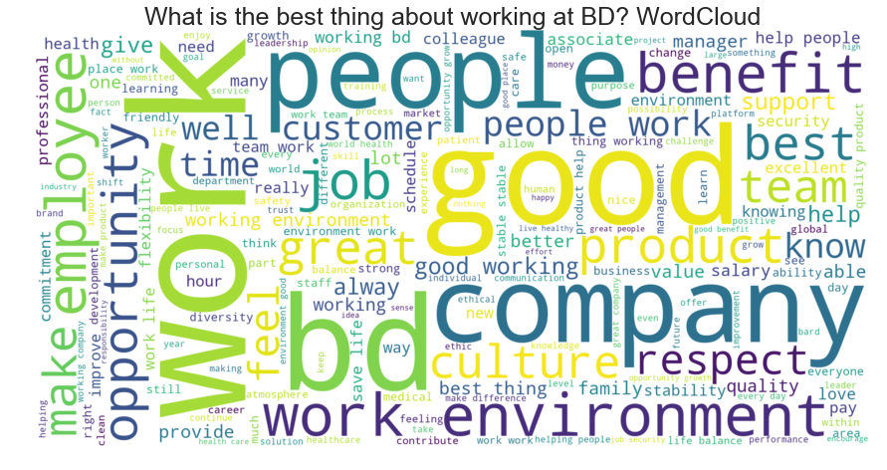
Results - Word Clouds

Slide 24
Results - Topic Modeling
What is topic modeling?
A way for us to group the free response texts into “topics”
10 Topics were made the describe general trends from the free response text box
Done use NLTK

Slide 25
Results - VoA Topic Modeling
Topic 0 : "quality, security, products, job, work, excellent, good, friendly, worklife, family"
Topic 1 : "team, work, opportunities, balance, life, job, hours, growth, personal, good"
Topic 2: "stability, lives, save, products, security, company, work, bd, making, time"
Topic 3: "people, work, help, respect, helping, good, products, product, great, working"
Topic 4: "culture, good, pay, company, atmosphere, money, values, working, bd, work"
Topic 5: "clean, work, treatment, environment, place, good, schedule, safety, safe, schedules"
Topic 6: "environment, work, working, good, flexible, safe, well, company, health, insurance"
Topic 7: "stable, opportunity, like, company, new, work, diversity, health, world, make"
Topic 8: "benefits, flexibility, work, good, colleagues, employees, coworkers, home, pay, environment"
Topic 9: "salary, bd, work, great, professional, associates, benefits, company, people, working"

Slide 26
Suggestions for Future Work
Individual analysis of country/region/function-based responses to see what are some top performers vs bottom performers
What are some differences between them?
Aside from the 5 questions that BD has internally analyzed, the other 64 questions can be examined more in depth as well
Continue with grouping and further break down the data
Look into the differences between Bard and BD
What are some insights that could help with strategy and improving outcomes?

Slide 27
Handoff Slide
A Zip File that includes:
Dataset
Code
Powerpoint - this presentation
Poster

Slide 28
Thank You
Thank you to BD for the opportunity!
Special thanks to:
Lilian Vinagre
Jeanne Helfant
Hemen Patel
Steve Richard

Slide 29
Becton Dickinson - Rutgers MBS Exchange
Part II
Part II - Travel & Expense Exploratory Analysis
Aditi Kulkarni, Wanfei (Felicia) Luo
Advisors: Dr. Christie Nelson, Lilian Vinagre, Jeanne Helfant, Hemen Patel

Slide 30
T&E Team Overview
Aditi Kulkarni
Wanfei (Felicia) Luo

Slide 31
Overview
In this project we are looking at the expenses to try and identify the problem areas using both descriptive and predictive analytics on travel and expense data.
List of anomalies we detected the problem within:
A large amount of dinners
Gift cards
Charges not approved on the BD T&E Policies

Slide 32
Approach
Identify Project Objective
Review Data
Select & Clean Data
Manipulate Data
Evaluate Model &
Conclusion
Programming Language: R

Slide 33
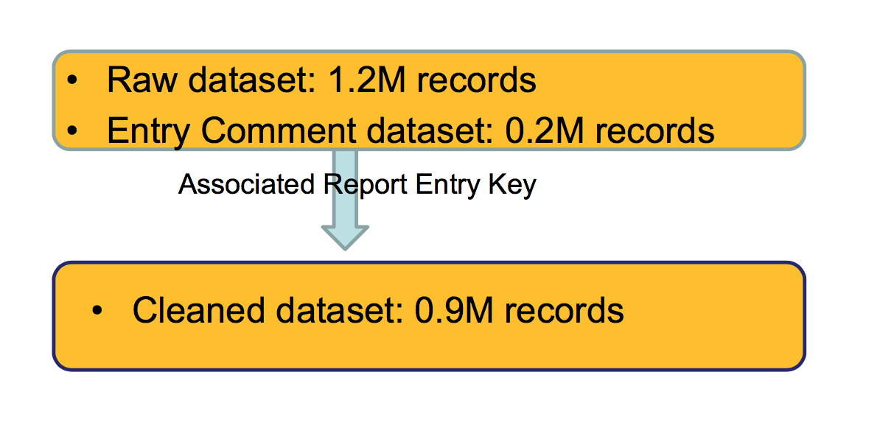
T&E Data

Slide 34
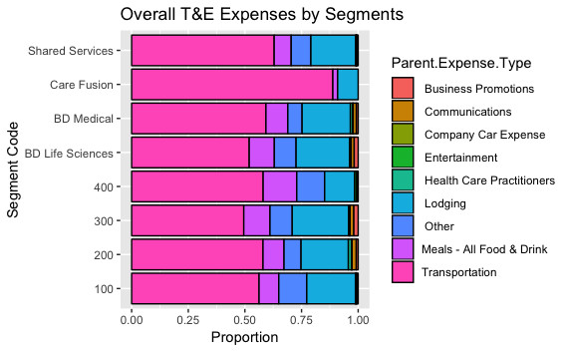
Data Visualization on the Basis of Parent Expenses
We wanted to visualize each of the segments based on the parental expenses, and see which parent expense contributed to most spending in each of the segments
Transportation was the highest parent expense in all of the segments (more than 40% of expenses)
Method: ggplot

Slide 35
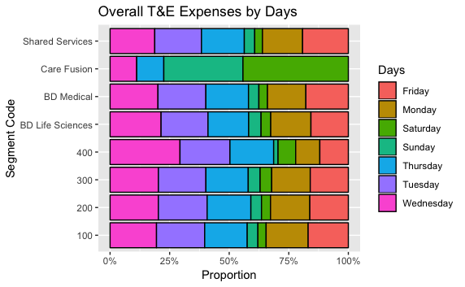
Data Visualization of Expenses on the Basis of Days
We wanted to visualize each of the segments based on the days the expenses were made and see on which days the expenses were the most
Most of the days that recorded expenses greater than 20% were on weekdays, but some expenses were also recorded on Saturday and Sunday

Slide 36
Self Meal Expenses and HCP Meal Expenses

Slide 37
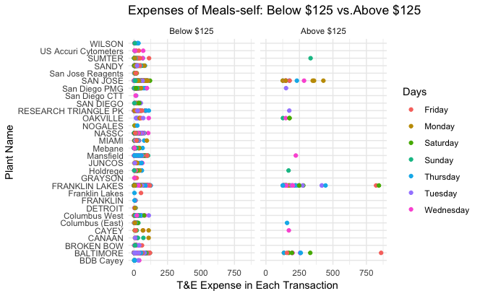

Slide 38
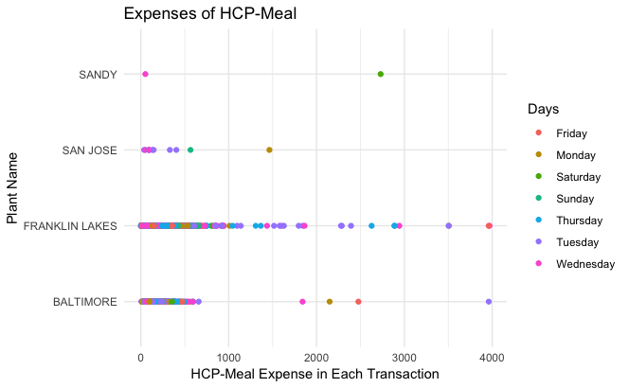

Slide 39
Insights from Results
We wanted to visualize the expenses especially for self meal and HCP in a scatterplot manner in order to check whether each data complies with the threshold (that is $125 on the BD T&E Policy).
There were instances were receipts were recorded greater than $125, and for HCP meals that were greater than $1000.
Some of the meal expenses were also itemized on the weekends.

Slide 40
Text Mining and Visualization of Expense Comments

Slide 41
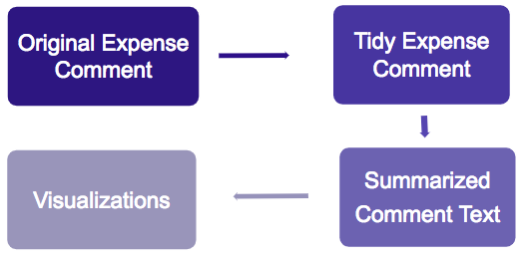
METHODOLOGY - TEXT MINING

Slide 42
Approach
In order to filter out some of the high frequency words within the expense comments, we had to implement text mining to R.
By tidying up the expense comments and summarizing it, we were able to visualize the words that occur more frequently.
In R, the packages include: tidytext, scales, and tidyr.

Slide 43
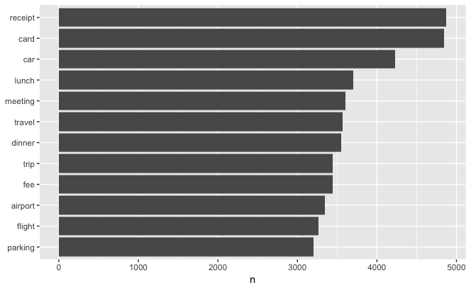
Expense Comments

Slide 44
Insights from Results
Once the comments were summarized and visualized, the top 3 high frequency words within the expense comments were:
Receipt
Card
Car
We eliminated any prepositions, articles and conjunctions from the visualization
Since the generalized high frequency words did not give any inference under what parent expense it came under, we sought to text mine the high frequency words on the basis of parent expense

Slide 45
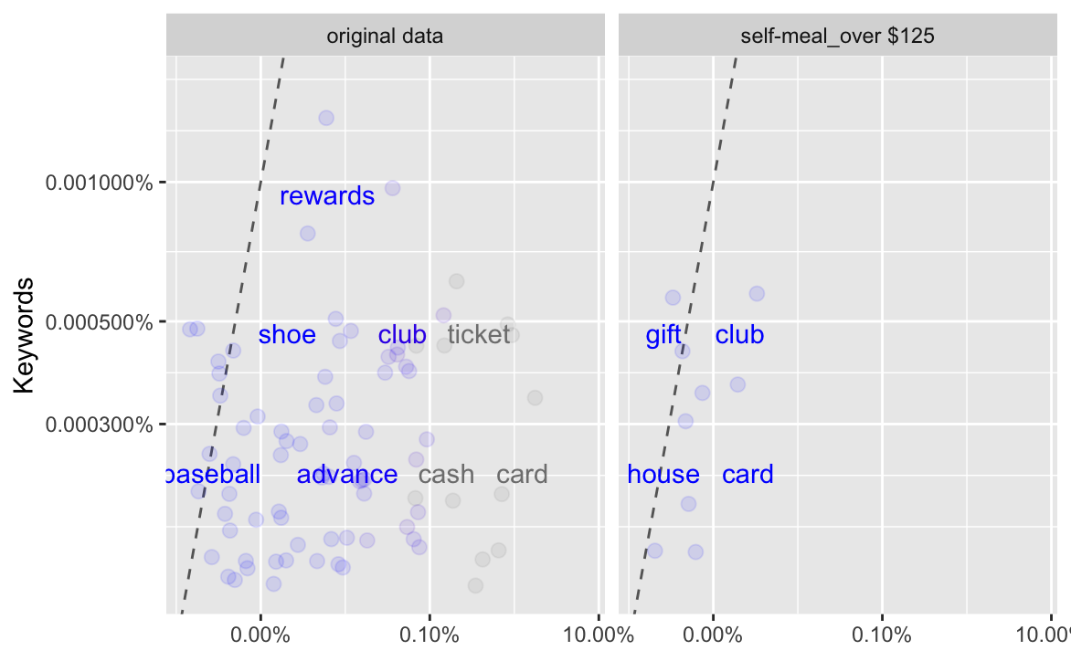
Expense comments vs. BD_Keywords

Slide 46
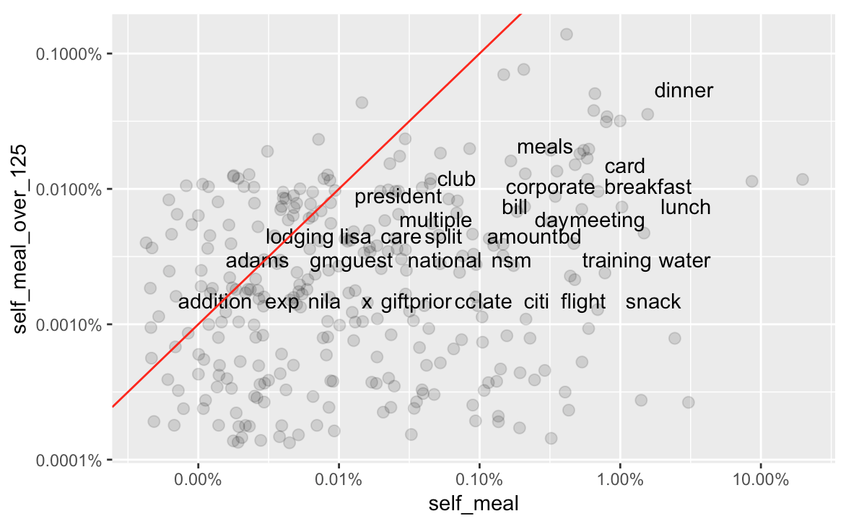
Self-meal under $125 vs. Self-meal over $125

Slide 47
Insights from Results
The high frequency words between original data and subset --- self-meal_over125 are different regarding the BD_keywords.
Words near the line are used with about equal frequencies by self-meal and self-meal_over125, while words that are far away from the line occur frequently in one subset.
Thus, words like dinner or lunch predominantly appear within the self-meal subset.

Slide 48
Conclusions
Identified hotspots with high expense variations within the self-meal and HCP meal, and overall T&E expenses by days and parent expense
Our model shows that the differences of keywords between the overall data and anomalous data depending on the subsets we have chosen

Slide 49
Suggestions for Future Works
Designing a tool to apply Sentiment analysis (scoring system) to further explore and predict the anomalous T&E expense
Identifies the comments within the excel sheet, scores these phrases (roughly - 1 to +1), and then combines these scores to discern the overall sentiment of the comment
Tidying up the excel sheet by:
Inserting fields like ‘Time’ to each receipt that has been itemized
Recording the number of individuals present during the HCP meal and self-meal to create an accurate visualization on the anomaly scatter plot

Slide 50
Thank You
Thank you to BD for the opportunity!
Special thanks to:
Lilian Vinagre
Jeanne Helfant
Hemen Patel
Steve Richard

Slide 51
Becton Dickinson - Rutgers MBS Exchange
Wrap Up & Handoff

Slide 52
MBS-BD Wrap Up and Handoff
Handoff of both projects (project files, additional Q&A, etc)
Continuation of either project into a future semester?
Other projects or ideas of future partnership

Slide 53
Follow Up
Thank you for partnering with us!
MBS Contact:
Dr. Christie Nelson cnelson@dimacs.rutgers.edu
Additional Information about our Externship Exchange can also be found at:
mbs.rutgers.edu/externships

